Slide 1

Patentability of subject-matter in the field of biotechnology in Europe
Dr. Andrea Schüssler

Slide 2
Topics
Patent Protection at the EPO
Unitary Patent and Unified Patent Court system
Recent Changes to the European Patent Convention (EPC)
Biotech/Pharma Related Patentability
Diagnostic Methods
Computer Implemented Inventions
Double Patenting
Biosimilars – Emerging markets in Europe
© HUBER & SCHÜSSLER 2010 |

Slide 3
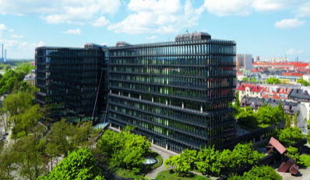
The Examination Procedure at the EPO
FILE
APPLICATION
Munich
The Hague
Berlin
SEARCH AND
EXAMINATION
ORAL
PROCEEDINGS
(Possibly)
Grant?
N
APPEAL
PROCEDURE
Y
ORAL
PROCEEDINGS
APPEAL
SUCCESS-
FULL?
Y
N
PATENT
GRANTED
REFUSAL

Slide 4
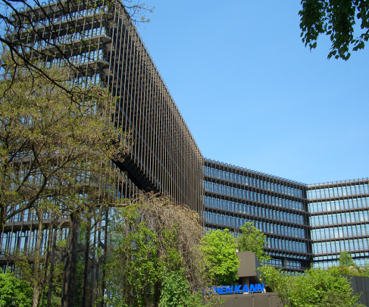
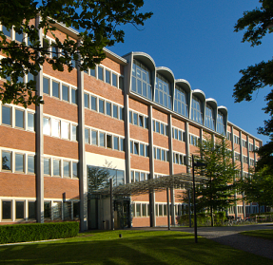
Procedure after EP Patent Grant
EP
Patent Granted
N
Opposition
Filed?
Y
Limitation
Procedure
Opposition
Procedure
No national nullity
possible
Oral Proceedings
National Law
Appeal
Procedure
German Fed.
Patent Court
Oral
Proceedings
Patent
Maintained
Patent Revoked

Slide 5
Unitary Effect of EP Patent After Grant (EU 1257/2012)
Same grant procedure for EP bundle patent and European patent with unitary effect
Appeal
proceedings
European
patent
application
Refusal or
withdrawal
of
application
Limitation
Revocation
Opposition
proceedings
European bundle patent
Validation in one or more
designated countries
On
decision
of the
patent
proprietor
Not yet possible:
European patent
with unitary effect
in the territories
of the 25 participating
Member States
Filing and
formalities
examination
Search report
with preliminary
opinion on
patentability *)
Substantive
examination
Grant of
European
patent
*) The EPO delivers its search reports, including written opinion on patentability, in less than 10 months on average, and in
less than 6 months for EPC-direct applications
Notes:
5
-

Slide 6
Status Quo of the Unitary Patent System
EU patent package:
(a) Unitary Patent: Agreement entered into force on January 20, 2013 but will be applicable only from the date of the entry into force of the Agreement on a Unified Patent Court
(b) Unified Patent Court: Agreement was signed by the 25 member states on February 19, 2013 and will enter into force as soon as 13 states, including France, Germany and the UK, have ratified it.

Slide 7
Status Quo of the Unitary Patent System
Agreement on the Unified Patent Court has been ratified by 5 states (Austria, France, Sweden, Belgium, Denmark)
UK plans to ratify in March 2015
Germany wishes to wait for the conclusion of the preparatory work for the court system once altogether 12 states including UK have ratified
Selection of the Judges is in progress
Questions on the level of costs (both Unitary Patent and Unified Patent Court ) remain still open
Current timetable foresees a launch of the new system not before the end of 2015

Slide 8
Status Quo of the Unitary Patent System
When the new system gets in place the situation becomes more complex
Creates different Europes:
  EU member states (27; e.g. Switzerland, Norway and Turkey are not EU members)
  EPC designation states (38, including Switzerland, Norway and Turkey)
  Unitary Patent: EU member states except Spain and Italy (UP-25)
  Unitary Patent Court: EU member states except Spain and Poland

Slide 9
Unified Patent Court
Infringement
actions and counter claims validity (nullity)
Local or
Regional
Divisions
European
patent and European patent with unitary effect
Court of First
Instance
European
Court of
Justice
Court of
Appeal
Luxemburg
in case of
litigation
Central
Division
Paris
Munich (Tech)
London (Bio)
Appeal on
Matters of Fact
and Points of Law
Preliminary
Rulings on
Union Law
Revocation
actions
Notes:
9
-

Slide 10
Unified Patent Court (Central Division)
London Section Paris Section * Munich Section
Human necessities (B) Performing Operations (F) Mechanical eng. Transporting, Lighting, Heating, Weapons, Blasting
(C) Chemistry, metallurgy (D) Textiles, paper
(F) Fixed constructions
(G) Physics
(H) Electricity
* Seat of Court President
Notes:
10
-

Slide 11
Unified Patent Court (Local/Regional Divisions)
In Germany local divisions are envisaged in Düsseldorf, Mannheim, Munich and Hamburg
Sweden, Estonia, Latvia and Lithuania agreed to set up a regional division

Slide 12

Recent Changes to the EPC (1)
New Regulation concerning Divisional Applications:
Past Situation (after April 1, 2010) - Rule 36 EPC:
Strict time limits as to when divisional applications could be filed
Divisional Applications could only be filed if one of the following time limits (I) or (II) had not yet expired:
(I) 24 months from issue of the FIRST Official Communication from the Examining Division on the earliest application („voluntary divisional“)
(II) 24 months from a Communication from the Examining Division in which a lack of unity objection is raised for the FIRST time
© HUBER & SCHÜSSLER 2010 |

Slide 13
Recent Changes to the EPC (2)
New Regulation became effective April 1, 2014 (return to the situation prior to April 1, 2010) :
Divisional Applications can be filed at any time while the parent application remains pending.
However, the EPO implemented an additional fee as part of the filing fee for divisional applications of second and subsequent generations:
Filing Fee (= First Generation): EUR 210.00
Additional Fee Second Generation: + EUR 210.00 = EUR 420.00
Additional Fee Third Generation: + EUR 420.00 = EUR 630.00
Additional Fee Fourth Generation: + EUR 630.00 = EUR 840.00
Additional Fee Fifth + subseq. Generation: + EUR 850.00 = EUR 1050.00
© HUBER & SCHÜSSLER 2010 |

Slide 14
Recent Changes to the EPC (3)
New Regulation concerning searches after unity objection in a Euro-PCT application (Rule 164 EPC)
Effective: November 1, 2014
Under the old Rule 164 EPC the EPO searched the invention first mentioned in the claims of a Euro-PCT. The applicant (who was often not aware of a unity problem under EPC since it was not objected to by other international Searching Authorities during the PCT phase) had no choice which invention shall be searched by the EPO after entrance into the regional EP phase.
© HUBER & SCHÜSSLER 2010 |

Slide 15
Recent Changes to the EPC (4)
Under the amended Rule 164 EPC applicants may obtain, upon payment of a (further) search fee, a search of any invention claimed which was not searched by the EPO in the international phase.
Amended Rule 164 EPC ensures that all applicants, irrespective of their choice of route (Euro-direct or Euro-PCT) and international Searching Authority (EPO or another ISA) have equal rights regarding the prosecution of their application in the European phase, especially in the case on non-unity.
© HUBER & SCHÜSSLER 2010 |

Slide 16
Biotech/Pharma related patentability
Requirements in the EPC
1. Exclusions from Patentability
2. Invention – Discovery: Art 52(2)(3), Rule 27(a), Rule 29(1)(2)
3. Novelty: Art 54
4. Inventive step: Art 56
5. Industrial application: Art 57, Rule 29(3)
6. Sufficiency of disclosure: Art 83, Rule 31
7. Morality: Art. 53(a), Rule 28

Slide 17
Biotech/Pharma related patentability
Requirements in the EPC
Patentable Inventions - Art. 52, 53(c) EPC
European patents shall be granted for any inventions which are
susceptible of industrial application, which are novel and which
involve an inventive step (Art. 52(1) EPC)
Methods for treatment of the human or animal body by surgery
or therapy and diagnostic methods practised on the human or
animal body shall not be regarded as inventions which are
susceptible of industrial application (Art. 53(c) 1st sentence EPC).
This provision shall not apply to products, in particular substances or compositions, for use in any of these methods (Art. 53(c) 2nd sentence EPC).

Slide 18
Biotech/Pharma related patentability
Requirements in the EPC
The provisions of novelty shall not exclude the patentability of
any substance or composition comprised in the state of the art,
for use in a method referred to in Article 53(c) EPC, provided that
its use for any method referred to in that paragraph is not comprised in
the state of the art.
Permits purpose-related product protection for a medical use (Art. 54(4) EPC)
Permits purpose-related product protection for each further medical use (Art. 54(5) EPC)
For substance already known as a medicine second medical use is limited to specific use

Slide 19
Biotech/Pharma related patentability
Patentable Inventions
Under the new EPC 2000 as of December 13, 2007:
Substance (Product claim)
Pharmaceutical composition comprising the substance (1st medical use)
Substance for use in treating or preventing disease state Y.
Substance for use in a method for the treatment of disease state Y.
Substance for use in a method of treating disease state Y.
Substance for use in the treatment of disease state Y.
NOT: Substance X for treating disease state Y.
Substance X for (in) a method of treating a disease state Y.
To avoid lack of clarity and resulting lack of novelty
objections use “for use”

Slide 20
Biotech/Pharma related patentability
In the past few years there have been several key decisions of the Enlarged Board of Appeals (EBA) concerning the patentability of biotech/pharma related inventions
General remark:
The Enlarged Board of Appeals is no „real“ instance after the Technical Board of Appeals but if there are diverging decisions of different Technical Boards of Appeals or if a point of law of fundamental importance arises, the Technical Appeal Board members or the president of the EPO can formulate questions which are submitted to the Enlarged Board of Appeal for clarification.
[Any party to appeal proceedings may file a petition to the EBA only if there was a violation of law during an appeal decision (e.g. violation of right to be heard, decision based on a criminal act).]
© HUBER & SCHÜSSLER 2010 |

Slide 21
Biotech/Pharma related patentability
Decision of the Enlarged Board of Appeal G 2/08
Decision was based on:
1. The use of nicotinic acid or a compound metabolized to nicotinic acid by the body selected from a group consisting of (…), for the manufacture of a sustained release medicament for use in the treatment by oral administration once per day prior to sleep, of hyperlipidaemia characterized in that the medicament does not comprise in admixture (…).
© HUBER & SCHÜSSLER 2010 |

Slide 22
Biotech/Pharma related patentability
Decision of the Enlarged Board of Appeal G 2/08
Question (1):
Where it is already known to use a particular medicament to treat a particular illness, can this known medicament be patented under the provisions of Art. 53(c) and 54(5) EPC 2000 for use in a different, new and inventive treatment by therapy of the SAME illness ?
✦ Where it is already known to use a medicament to treat an illness, Art. 54(5) EPC does NOT exclude that this medicament be patented for use in a different treatment by therapy of the same illness.
© HUBER & SCHÜSSLER 2010 |

Slide 23
Biotech/Pharma related patentability
Decision of the Enlarged Board of Appeal G 2/08
Question (2):
If the answer to question 1 is yes, is such patenting also possible where the only novel feature of the treatment is a new and inventive dosage regime?
✦ Such patenting is also not excluded where a dosage regime is the ONLY feature claimed which is not comprised in the state of the art.
© HUBER & SCHÜSSLER 2010 |

Slide 24
Biotech/Pharma related patentability
Decision of the Enlarged Board of Appeal G 2/08
Question (3):
Are any special considerations applicable when interpreting and applying Articles 53 (c) and 54(5) EPC 2000?
✦ Where the subject matter of a claim is rendered novel only by a new therapeutic use of a medicament, such claim may no longer have the format of a so-called Swiss type claim as instituted by decision G 5/83.
Prior to G 2/08:
Use of a substance X for preparing a pharmaceutical composition for treating disease Y
After G 2/08:
Substance X for use in a method of treating disease Y (c.f. above)
© HUBER & SCHÜSSLER 2010 |

Slide 25
Biotech/Pharma related patentability
Examples for patentable Inventions
“Pigs/Duphar” T 19/86 Subgroup of patients
Known: The use of live attenuated Aujeszky virus to protect by intranasal administration sero-negative piglets
Invention: The use of a live attenuated Aujeszky-virus for the manufacture of a vaccine for intranasally protecting maternally immune pigs against Aujeszky‘s disease.
(maternally immune = sero-positive)
Difference to the prior art:
Different immunologically population of animals but same species, same disease, same medicament

Slide 26
Biotech/Pharma related patentability
Examples for patentable Inventions
Method of administration (IGF-i) T1020/03
Claim 13:
Use of insulin-like growth factor-I (IGF-I) in the preparation of a
medicament for treating chronic renal failure (…) wherein the
administration pattern of the medicament comprises administering a
therapeutically effective amount of insulin-like growth factor-2 (IGF-I) to the mammal to provide an exposure to IGF-I for from about three to
twelve days, then discontinuing said administration for from about two to seven days, then administering a therapeutically effective amount of IGF-I to the mammal to provide an exposure to IGF-I for from about three to twelve days, then (…) of time equal to or less than the time period during which the IGF-I was just previously administered.

Slide 27
Biotech/Pharma related patentability
Examples for patentable Inventions
Method of administration (IGF-i) T1020/03
The Board noted:
The present application was based on the finding that instead of continuous treatment with IGF-I of patients with chronic diseases, such as chronic renal failure, which became ineffective over time, cycles of treatment („intermittent“ treatment) using IGF-I could bring about a prolonged effective benefit.

Slide 28
Biotech/Pharma related patentability
Examples for patentable Inventions
Method of administration (IGF-i) T1020/03
The Board decided:
Any use to which Article 52(4) EPC1973 [now Art. 53(c) EPC2000] first sentence applies in circumstances where the composition has already been suggested for some therapeutic use, allows a second medical use claim to the preparation of the composition for that second medical use, irrespective of in what detail that use was specified, subject to the use being novel and inventive. For the purposes of novelty also under Art. 54(5) EPC this depends on whether use for therapy is novel, irrespective of the detail with which the therapy is stated in the claim.
Result: Patent Allowable

Slide 29
Diagnostic Methods
Decision of the Enlarged Board of Appeals G 1/07
Decision was based on:
1. A method for MRI imaging the pulmonary and/or cardiac vasculature using dissolved-phase polarized 129Xe, comprising the steps of:
positioning a patient in an MRI apparatus (…);
delivering polarized 129Xe gas to a predetermined region of the patient´s body, the polarized gas (…)
exciting a predetermined region of the patient´s body, having a portion of the dissolved phase polarized gas therein with (…) an excitation pulse;
acquiring at least one MR image (…).
© HUBER & SCHÜSSLER 2010 |

Slide 30
Diagnostic Methods
Decision of the Enlarged Board of Appeal G 1/07
Further indepedent claims:
11. A method of deriving a spectroscopic signal representative of a blood volume or a blood flow rate of the patient, comprising the steps of: (...).
17. A cardiac imaging method, comprising the steps of: (…).
Problem:
All claimed methods comprise the step of delivering polarized 129Xe to the subject, in particular via inhalation.
However, an injection of polarized 129Xe into the heart as mentioned in the description is encompassed by the claims, in particular in the context of the cardiac imaging method.
© HUBER & SCHÜSSLER 2010 |

Slide 31
Diagnostic Methods
Decision of the Enlarged Board of Appeal G 1/07
Question (1):
Is a claimed imaging method for a diagnostic purpose which comprises or encompasses a step consisting in a physical intervention practiced on the human or animal body (in the present case, an injection of a contrast agent into the heart), to be excluded from patent protection as a „method for treatment of the human or animal body by surgery“ pursuant to Article 52(4) EPC if such step does not per se aim at maintaining life and health?
✦ A claimed imaging method, in which, when carried out, maintaining the life and health of the subject is important and which comprises or encompasses an invasive step representing a substantial physical intervention on the body which requires professional medical expertise to be carried out and which entails a substantial health care risk, is EXCLUDED from patentability as a method for treatment of the human or animal body by surgery pursuant to Article 53(c) EPC.
© HUBER & SCHÜSSLER 2010 |

Slide 32
Diagnostic Methods
Decision of the Enlarged Board of Appeal G 1/07
Question (2):
If the answer to (1) is in the affirmative, could the exclusion from patent protection be avoided by amending the wording of the claim so as to omit the step at issue, or disclaim it, or let the claim encompass it without being limited to it ?
(2a) A claim which comprises a step encompassing an embodiment which
is a „method for treatment (…).“ cannot be left to encompass that
embodiment.
(2b) The exclusion from patentability under Art. 53(c) EPC can be avoided
by disclaiming the embodiment, it being understood that in order to be
patentable the claim including the disclaimer must fulfill all the
requirements of the EPC (including G 1/03, G2/03).
(2c) Whether or not the wording of the claim can be amended so as
to omit the surgical step without offending against the EPC
must be assessed on the individual case under consideration.
© HUBER & SCHÜSSLER 2010 |

Slide 33
Diagnostic Methods
Decision of the Enlarged Board of Appeal G 1/07
Question (3):
Is a claimed imaging method for a diagnostic purpose to be considered as being a constitutive step of a „treatment of the human or animal body by surgery“ pursuant to Art. 52(4) EPC if the data obtained by the method immediately allow a surgeon to decide on the course of action to be taken during a surgical intervention?
✦ A claimed imaging method is not to be considered as being a „treatment of the human or animal body by surgery“ within the meaning of Art. 53(c) EPC merely because during a surgical intervention the data obtained by the use of the method immediately allow a surgeon to decide on the course of action to be taken during a surgical intervention.
© HUBER & SCHÜSSLER 2010 |

Slide 34

Diagnostic Methods
Decision of the Enlarged Board of Appeal G1/07
All questions removed
Answer (1):
A claimed imaging method, in which, when carried out, maintaining the life and health of the subject is important and which comprises or encompasses an invasive step representing a substantial physical intervention (???) on the body which requires professional medical expertise (???) to be carried out and which entails a substantial health care risk (???), is EXCLUDED from patentability as a method for treatment of the human or animal body by surgery pursuant to Article 53(c) EPC.
Answer (2c):
Whether or not the wording of the claim can be amended so as to omit the surgical step without offending against the EPC must be assessed on the basis of the overall cicumstances of the individual case under consideration (???).
  Conclusion: In-vitro methods routinely not a problem
  Imaging in-vivo depends on claim and method
© HUBER & SCHÜSSLER 2010 |

Slide 35
Computer-Implemented Inventions
Decision of the Enlarged Board of Appeal G 3/08
Art. 52 EPC:
(1) European patents shall be granted for any inventions, in all fields of technology, provided that they are new, involve an inventive step and are susceptible of industrial application.
(2) The following in particular shall not be regarded as inventions within the meaning of paragraph 1:
(…)
(c) Schemes, rules and methods for (…) doing business, and programs for computers;
(3) Paragraph 2 shall exclude the patentability of the subject- matter or activities (…) only to the extent to which a EP application or EP patent relates to such subject-matter or activities as such.
© HUBER & SCHÜSSLER 2010 |
Boston Presentation, May 25, 2010

Slide 36
Computer Implemented Inventions
Decision of the Enlarged Board of Appeal G 3/08
Computer implemented inventions:
Any invention of which the performance involves the uses of a computer, computer network or other programmable apparatus, the invention having one or more features which are realised wholly or partly by means of one or more computer programs.
✦ Solution to problems in the conventional field which propose the use of computer technology are in principle patentable.
✦ HOWEVER: Problems arise with the use of computer technology in conventional non-technical fields.
✦ Public interest currently focused on computer-implemented business methods:
- business methods as such excluded from patentability
- computer programs as such excluded from patentability
- combination thereof, e.g computerized means dealing with mail order over the internet
PATENTABLE ???
© HUBER & SCHÜSSLER 2010 |

Slide 37
Computer Implemented Inventions
Decision of the Enlarged Board of Appeal G 3/08
Technical Effect / Technical Character:
A technical effect can be deduced from:
- the object of the invention,
- how this object is solved,
- the effects,
- the necessity to make technical considerations.
HOWEVER:
✦ EPC does not contain any definition of what a „technical effect“/„technicity“means.
✦ These two terms have been developed and will be further developed in case law decisions.
© HUBER & SCHÜSSLER 2010 |

Slide 38
Computer Implemented Inventions
Decisions of the Enlarged Board of Appeal G 3/08
Question (1):
Can a computer program only be excluded as a computer program as such if it is explicitly claimed as a computer program ?
Question (2):
(a) Can a claim in the area of computer programs avoid exclusion under Art. 52(2) (c) and (3) merely by explicitly mentioning the use of a computer or a computer-readable storage medium ?
(b) If Question 2(a) is answered in the negative, is a further technical effect necessary to avoid exclusion, said effect going beyond those effects inherent in the use of a computer or data storage medium to respectively execute or store a computer program ?
© HUBER & SCHÜSSLER 2010 |

Slide 39
Computer Implemented Inventions
Decision of the Enlarged Board of Appeal G 3/08
Question (3):
(a) Must a claimed feature cause a technical effect on a physical entity in the real world in order to contribute to the technical character of the claim ?
(b) If Question 3(a) is answered in the positive, is it sufficient that the physical entity be an unspecified computer ?
(c) If Question 3(a) is answered in the negative, can features contribute to the technical character of the claim if the only effects to which they contribute are independent of any particular hardware that may be used ?
✦ Briefly, the decision made is such that the EBA will not be providing any new law, on the basis that current law is not divergent.
© HUBER & SCHÜSSLER 2010 |

Slide 40
Computer Implemented Inventions
Decision of the Enlarged Board of Appeal G 3/08
However, the Enlarged Board of Appeal made a very important clarification (paragraph 12.2.2 on page 50 of G 3/08):
“It is in fact a well-established principle that features which would, taken in isolation, belong to the matters excluded from patentability by Article 52(2) EPC may nonetheless contribute to the technical character of a claimed invention, and therefore cannot be discarded in the consideration of the inventive step. This principle was already laid down, albeit in the context of the so-called “contribution approach”, in one of the earliest decisions of the Boards of Appeal to deal with Article 52(2) EPC, namely T 208/84, VICOM (Reasons, point 4 ff.).”
This paragraph clearly states that so-called non-technical features, namely features which when taken in isolation are excluded from patentability as being non-technical features, have to be considered in the examination of the inventive step if they contribute to the technical character. This means that any non-technical feature which cooperates with other technical features in the claim to solve a technical problem cannot be deleted in examining the inventive step.

Slide 41
Double patenting at the EPO
What is double patenting?
Grant of a patent for
the same invention (→ claims, not description!)
the same applicant
the same country/countries, and
the same filing/priority date
No explicit provisions in the EPC regarding double patenting
BUT: According to the EPO it is “an accepted principle in most patent systems that two patents cannot be granted to the same applicant for one invention.” (Guidelines C-IV, 7.4)
Relevant e.g. for divisional applications
Parent and divisional “must not contain claims of substantially identical scope, but also that one application must not claim the subject-matter claimed in the other, even in different words.” (Guidelines C-VI, 9.1.6)

Slide 42
Double patenting at the EPO
Case law – more questions than answers
T 307/03
Art. 60(1) EPC (Right to a European Patent) → “right to the grant of one and only one patent [...] for a particular invention”
Exhaustion of right to grant of patent
Reference to national law (UK)
J 2/01 (right to file a divisional)
Strict interpretation of “same applicant”: addition of further applicant will get outside it?
G 1/05
“[…] applicant has no legitimate interest in proceedings leading to the grant of a second patent for the same subject matter […].” → What is the “same” subject matter?

Slide 43
Double patenting at the EPO
Case law – more questions than answers
T 1391/07 (November 2008):Technical Board of Appeals 3.4.02 held that a double patenting objection did not arise when the claims of two applications only overlap in such a manner that the scope of protection sought by the invention claimed in the divisional application was notionally different from the scope of protection conferred by the claims of the granted parent patent.
This was found by the Board 3.4.02 to be in line with decisions T 118/91, point 2.4.1 of the reasons,[22] T 80/98, point 9,[23] T 587/98 (OJ EPO 2000, 497), point 3.3,[7] T 475/02, point 8.6,[24] T 411/03, point 4.2,[25] T 425/03, point 4.2,[26] T 467/03, point 4.2, T 468/03, point 4.2,[27] and T 579/05, point 2.2,[28] and the obiter dictum in decisions G 1/05 and G 1/06.[21]

Slide 44
Double patenting at the EPO
Summary
No explicit provisions in the EPC → no prohibition?
Open question: What is the “same” invention/subject-matter?
T 307/03 will probably not be followed, inconsistent argumentation

Slide 45

Biosimilars – Emerging markets in Europe (1)
Biosimilars („follow-on biologics“): generic follow-on products of biotechnologically produced original medicaments
Risk of different efficacy and safety compared to the original product in view of production process complexicity
Main risk: immunogenicity (cannot be predicted in animal models)
Already since 2004 biosimilar guidelines of the EMEA : Europe has pioneer role worldwide
16 biosimilars registered in EU, 1 (pending) in USA [July 2014: Sandoz for „filgrastim“)
In comparison to „normal (chemical) generics“ higher standards to meet for registration
Generally medium sized registration studies and a surveillance of the patients after registration
© HUBER & SCHÜSSLER 2010 Boston Presentation, May 25, 2010
© HUBER & SCHÜSSLER 2010 |

Slide 46
Biosimilars – Emerging markets in Europe (2)
Biosimilars which are produced by bacterial-based procedures are easier and cheaper to produce than biosimilars which are produced by mice or hamster cell line-based procedures.
Registration standards (requirements to be fulfilled in clinical trials) lower for bacterial-produced biosimilars than for animal cell line-produced biosimilars
Most of the 16 EU-registered biosimilars (hGH, EPO, G-CSF) are bacterial-produced.
About 7 years development time, costs: 80-100 millions USD („normal“ generics: 3 years, 5-10 Mio USD).
© HUBER & SCHÜSSLER 2010 Boston Presentation, May 25, 2010
© HUBER & SCHÜSSLER 2010

Slide 47
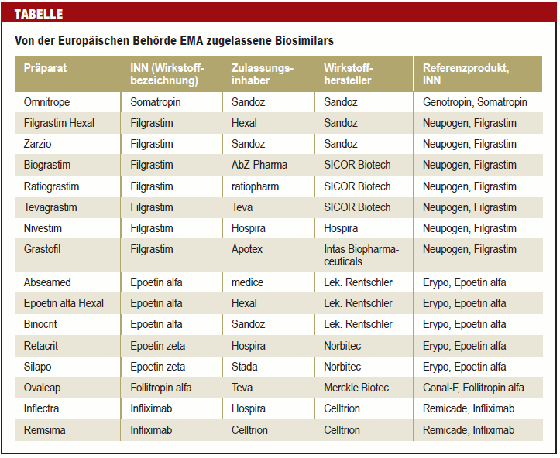
Biosimilars – Emerging markets in Europe (3)
© HUBER & SCHÜSSLER 2010 Boston Presentation, May 25, 2010
© HUBER & SCHÜSSLER 2010 |

Slide 48
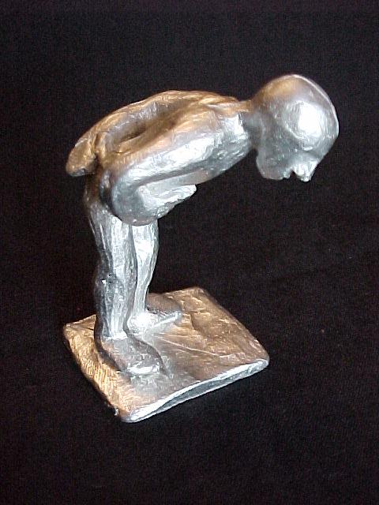
Dr. Andrea Schüssler
HUBER & SCHÜSSLER
Truderinger Strasse 246
81825 München schuessler@patservice.de www.patservice.de
Ahmedabad, February 2015
THANK YOU FOR YOUR KIND ATTENTION!

